Slide 1

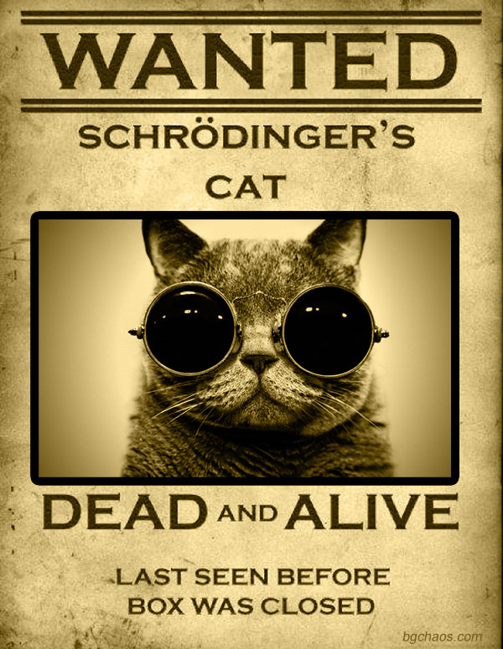
Solving Schrödinger Equation
Dec. 2018
Mehdi Hatefipour

Slide 2
Outline
How to solve time-independent Schrödinger equation(SE)?
Eigenfunctions and eigenvalues of some famous problems
How to solve time-dependent SE?
Time evolution of some wavefunctions
Future works

Slide 3
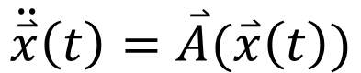
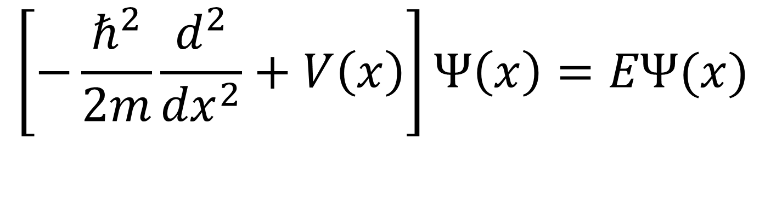
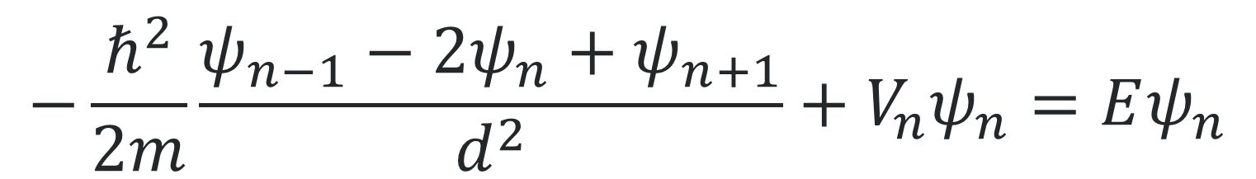
How to solve time-independent SE?
$$\left[−\frac{ℏ^{2}}{2m}\frac{d^{2}}{{dx}^{2}}+V\left(x\right)\right]Ψ\left(x\right)=EΨ(x)$$
Verlet
$$\ddot{\overset{⃑}{x}}\left(t\right)=\overset{⃑}{A}(\overset{⃑}{x}\left(t\right))$$
$${\overset{⃑}{x}}_{n+1}={2\overset{⃑}{x}}_{n}−{\overset{⃑}{x}}_{n−1}+\overset{⃑}{A}({\overset{⃑}{x}}_{n}){∆t}^{2}$$
$$−\frac{ℏ^{2}}{2m}\frac{ψ_{n−1}−2ψ_{n}+ψ_{n+1}}{d^{2}}+V_{n}ψ_{n}=Eψ_{n}$$

Slide 4
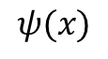
How to solve time-independent SE?
$$ψ(x)$$
x

Slide 5
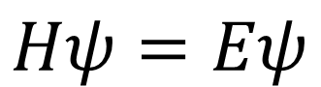
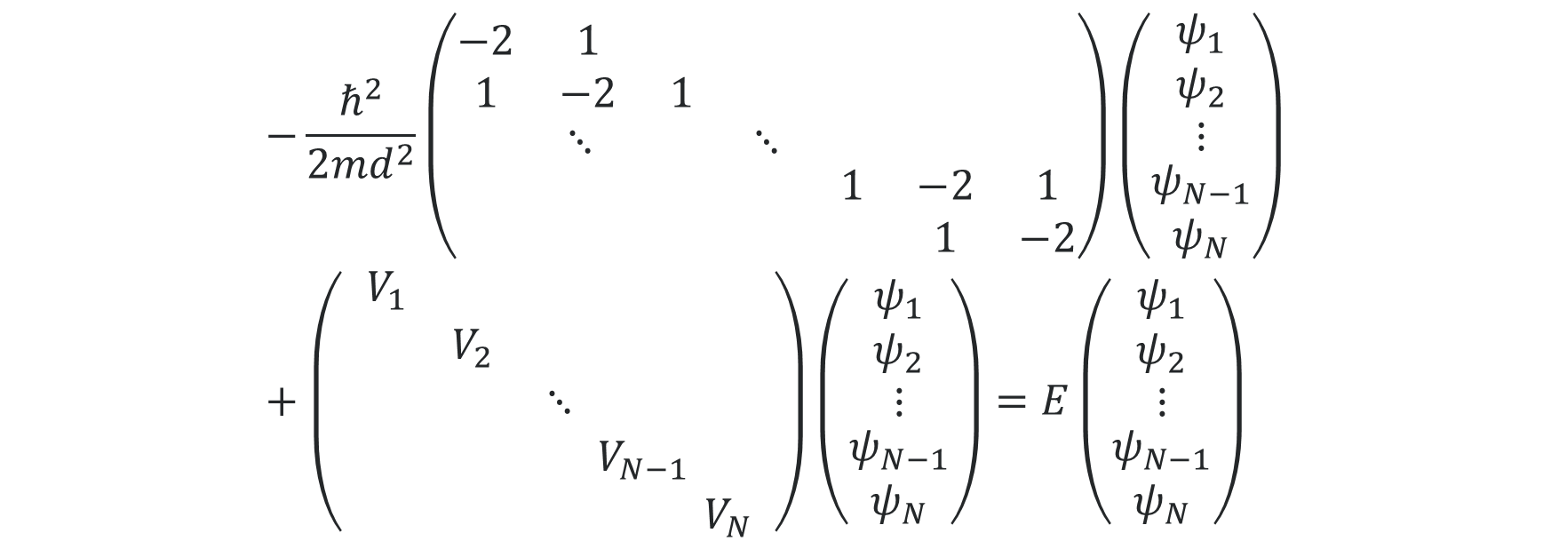
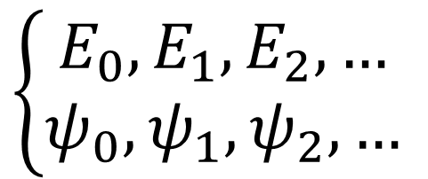
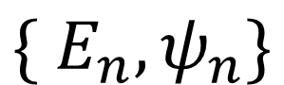
How to solve time-independent SE?
$$−\frac{ℏ^{2}}{2md^{2}}\left(\begin{matrix}\begin{matrix}−2 & 1 & \\ 1 & −2 & 1\end{matrix} & & \\ ⋱ & ⋱ & \\ & & \begin{matrix}1 & −2 & 1 \\ & 1 & −2\end{matrix}\end{matrix}\right)\left(\begin{aligned}\begin{aligned}\begin{matrix}ψ_{1} \\ ψ_{2} \\ ⋮\end{matrix} \\ ψ_{N−1}\end{aligned} \\ ψ_{N}\end{aligned}\right)+\left(\begin{aligned}\begin{aligned}\begin{matrix}V_{1} & & \begin{matrix} & \begin{matrix} & \end{matrix}\end{matrix} \\ & V_{2} & \begin{matrix} & \begin{matrix} & \end{matrix}\end{matrix} \\ & & \begin{matrix}⋱ & \begin{matrix} & \end{matrix}\end{matrix}\end{matrix} \\ \begin{matrix} & & \begin{matrix} & \begin{matrix}V_{N−1} & \end{matrix}\end{matrix}\end{matrix}\end{aligned} \\ \begin{matrix} & & \begin{matrix} & \begin{matrix} & V_{N}\end{matrix}\end{matrix}\end{matrix}\end{aligned}\right)\left(\begin{aligned}\begin{aligned}\begin{matrix}ψ_{1} \\ ψ_{2} \\ ⋮\end{matrix} \\ ψ_{N−1}\end{aligned} \\ ψ_{N}\end{aligned}\right)=E\left(\begin{aligned}\begin{aligned}\begin{matrix}ψ_{1} \\ ψ_{2} \\ ⋮\end{matrix} \\ ψ_{N−1}\end{aligned} \\ ψ_{N}\end{aligned}\right)$$
$$\left\{\begin{aligned}E_{0}, E_{1}, E_{2},… \\ ψ_{0},ψ_{1},ψ_{2}, … \end{aligned}\right.$$
$$Hψ=Eψ$$
$$\{ E_{n},ψ_{n}\}$$
Sort

Slide 6
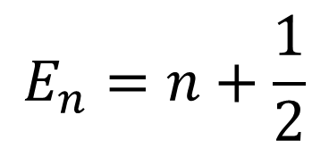
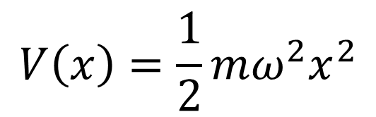
Eigenfunctions and eigenvalues of some famous problems
Checking the solution
$$V\left(x\right)=\frac{1}{2}mω^{2}x^{2}$$
$$E_{n}=n+\frac{1}{2}$$
Harmonic Oscillator
n | Energy (exact) | Energy (N=50) | Energy (N=100) | Energy (N=250)
0 | 0.5 | 0.5 | 0.5 | 0.5
1 | 1.5 | 1.49 | 1.5 | 1.5
2 | 2.5 | 2.48 | 2.5 | 2.5
3 | 3.5 | 3.47 | 3.49 | 3.5
4 | 4.5 | 4.45 | 4.49 | 4.5
5 | 5.5 | 5.42 | 5.48 | 5.5
6 | 6.5 | 6.39 | 6.47 | 6.5
7 | 7.5 | 7.36 | 7.47 | 7.5

Slide 7
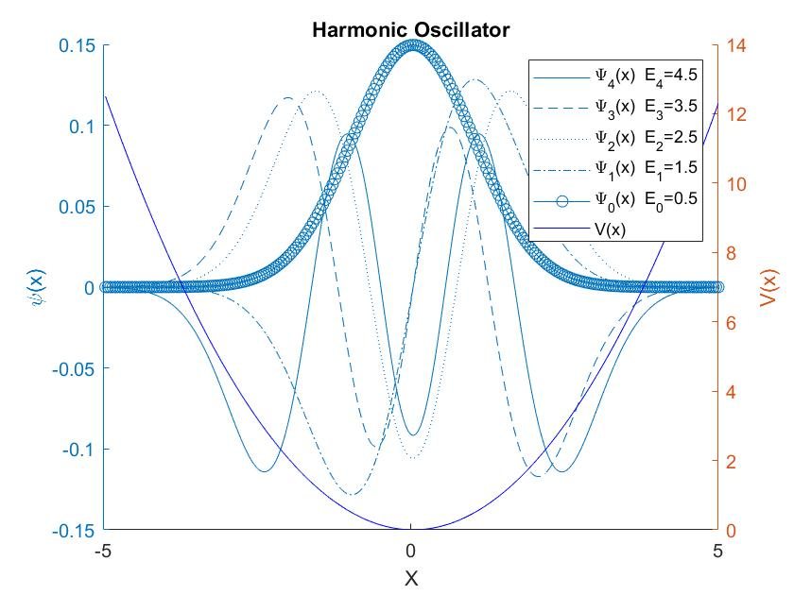
Eigenfunctions and eigenvalues of some famous problems

Slide 8
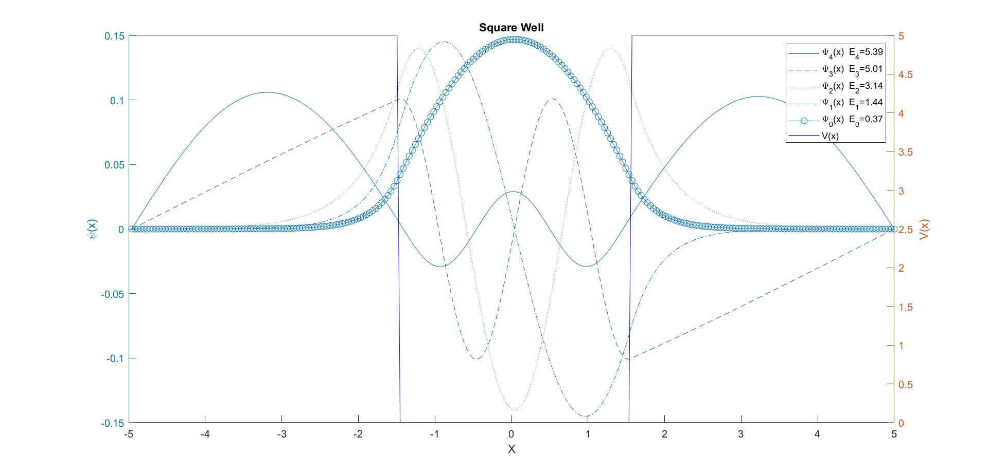
Eigenfunctions and eigenvalues of some famous problems

Slide 9
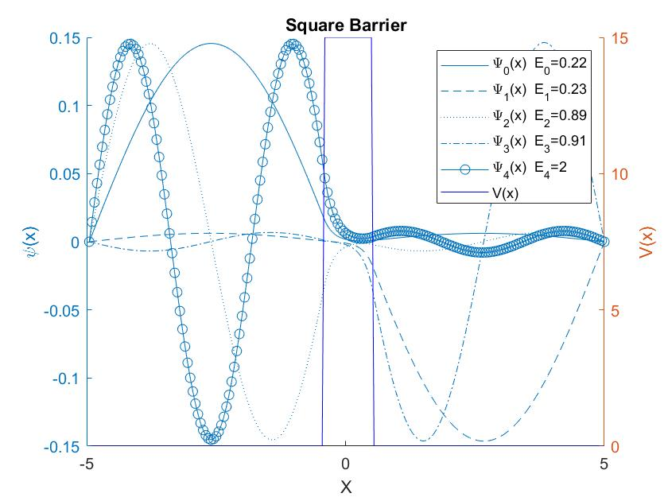
Eigenfunctions and eigenvalues of some famous problems

Slide 10
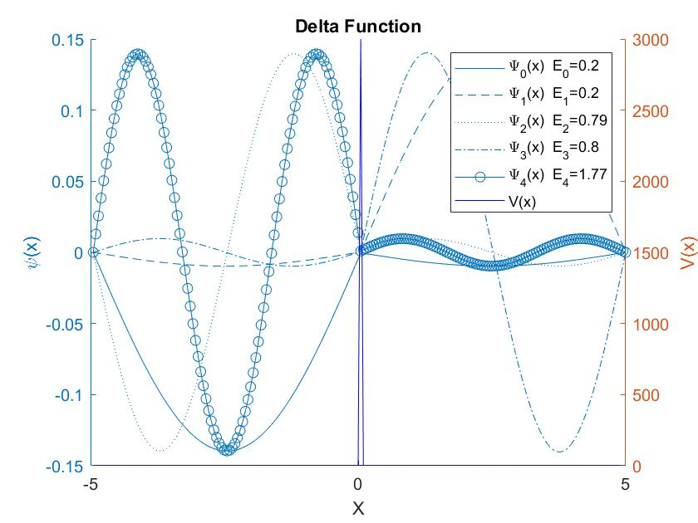
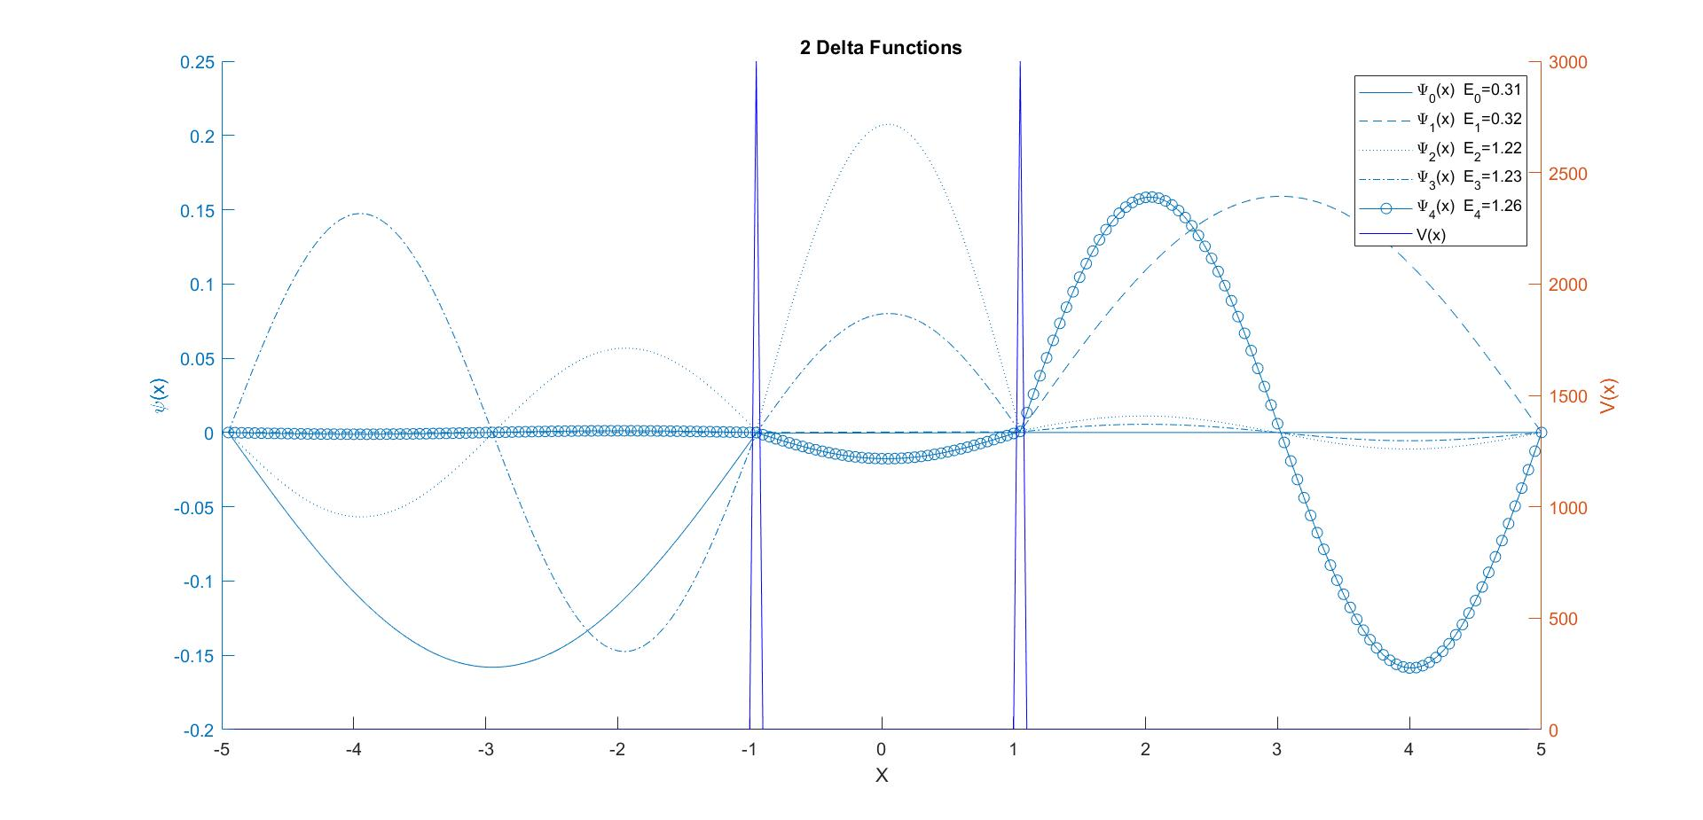
Eigenfunctions and eigenvalues of some famous problems

Slide 11
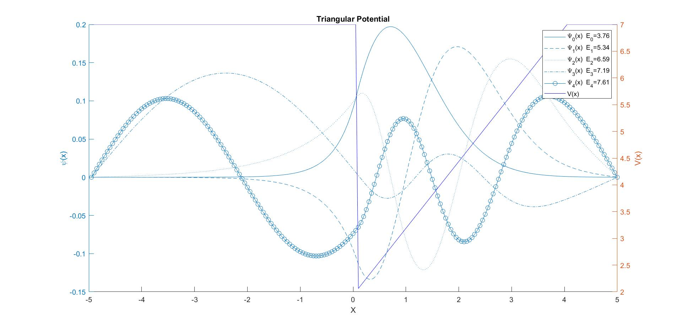
Eigenfunctions and eigenvalues of some famous problems

Slide 12
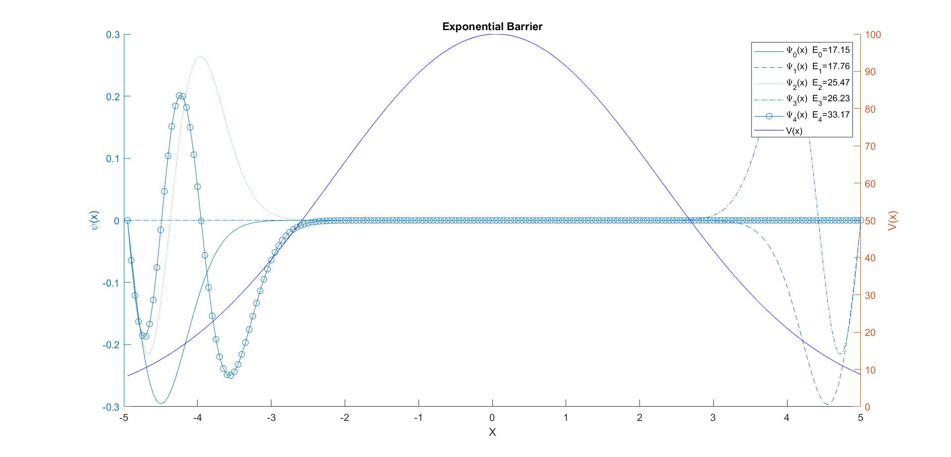
Eigenfunctions and eigenvalues of some famous problems

Slide 13
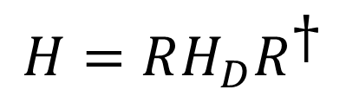
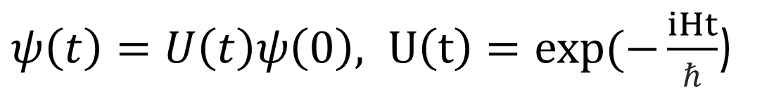
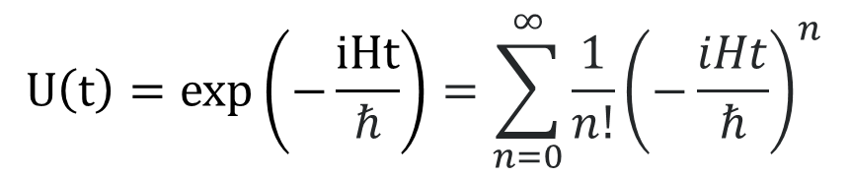
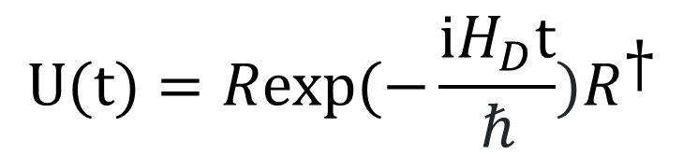
How to solve time-dependent SE?
$ψ\left(t\right)=U\left(t\right)ψ\left(0\right), U\left(t\right)=exp(−\frac{iHt}{ℏ}$)
Method 1
Method 2
$$H=RH_{D}R^{\text{†}}$$
$$U(t)=Rexp(−\frac{iH_{D}t}{ℏ})R^{\text{†}}$$
$$U\left(t\right)=exp\left(−\frac{iHt}{ℏ}\right)=\sum_{n=0}^{∞}{\frac{1}{n!}{\left(−\frac{iHt}{ℏ}\right)}^{n}}$$

Slide 14
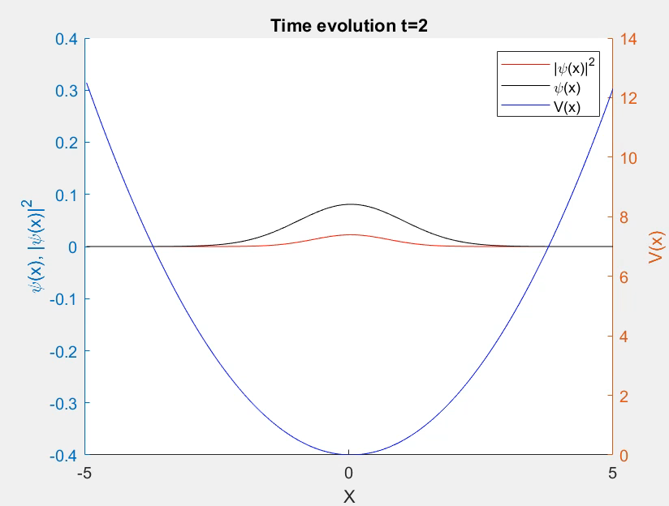
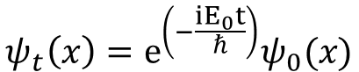
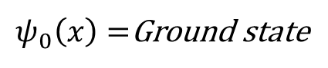
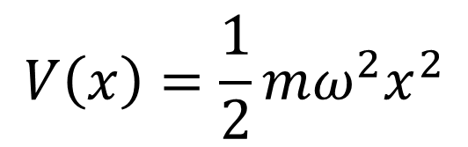
Time evolution of some wavefunctions
Checking the solution
$$V\left(x\right)=\frac{1}{2}mω^{2}x^{2}$$
$ψ_{0}\left(x\right)=$Ground state
Harmonic Oscillator
$$ψ_{t}\left(x\right)=e^{\left(−\frac{iE_{0}t}{ℏ}\right)}ψ_{0}(x)$$

Slide 15
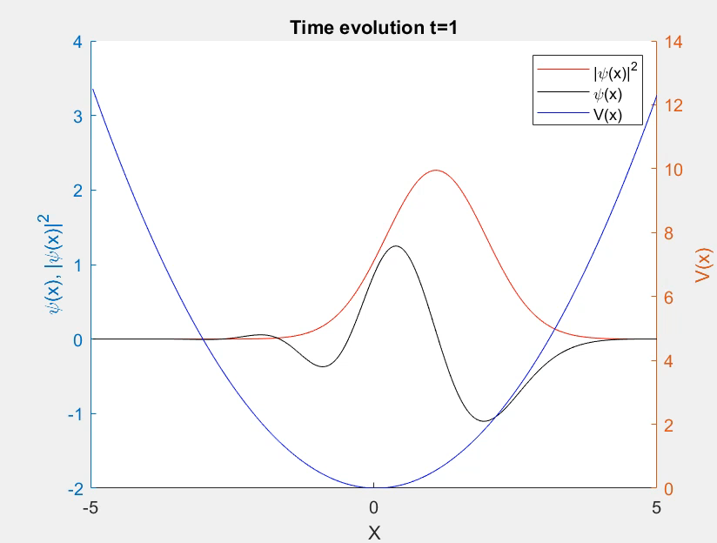
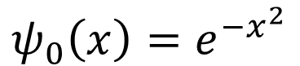
Time evolution of some wavefunctions
Harmonic oscillator
$$ψ_{0}\left(x\right)=e^{−x^{2}}$$

Slide 16
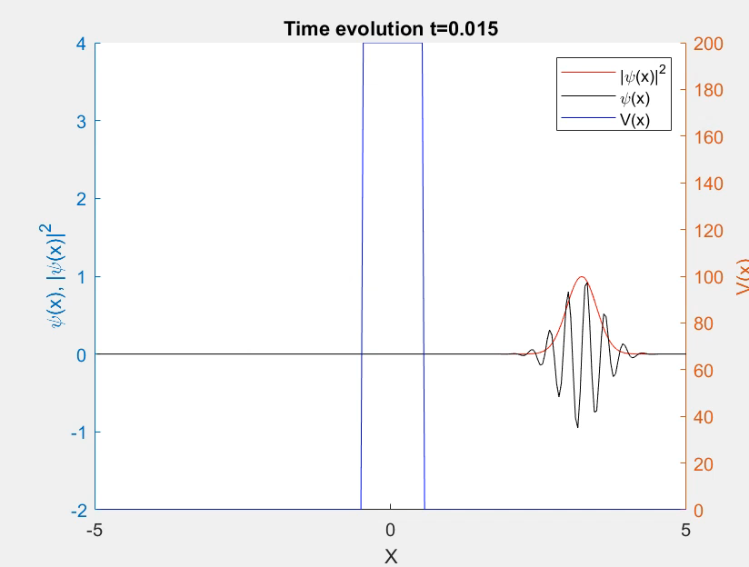
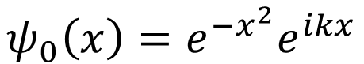
Time evolution of some wavefunctions
Tunneling
$$ψ_{0}\left(x\right)=e^{−x^{2}}e^{ikx}$$

Slide 17
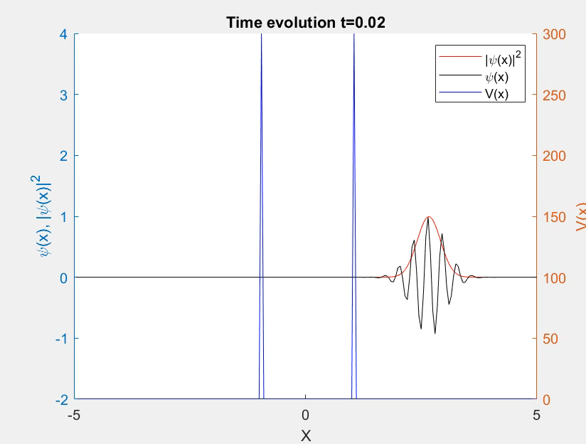
Time evolution of some wavefunctions
Delta function
$$ψ_{0}\left(x\right)=e^{−x^{2}}e^{ikx}$$

Slide 18
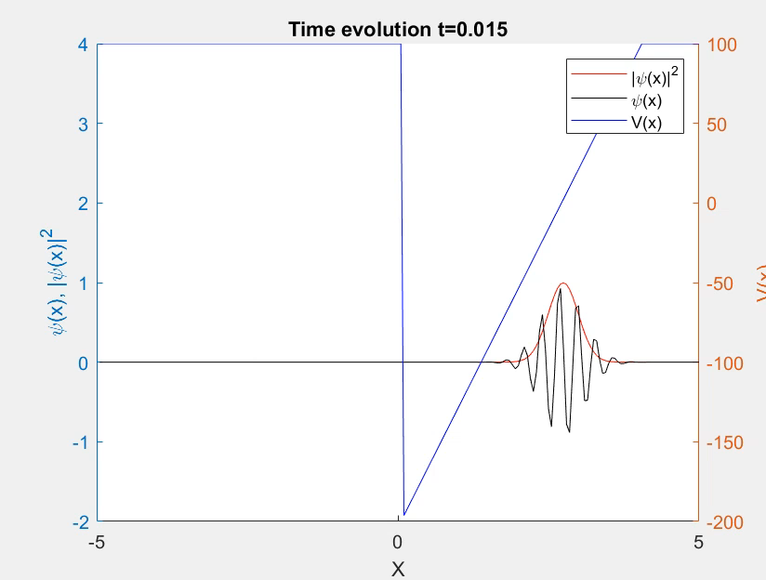
Time evolution of some wavefunctions
Triangular Potential
$$ψ_{0}\left(x\right)=e^{−x^{2}}e^{ikx}$$

Slide 19
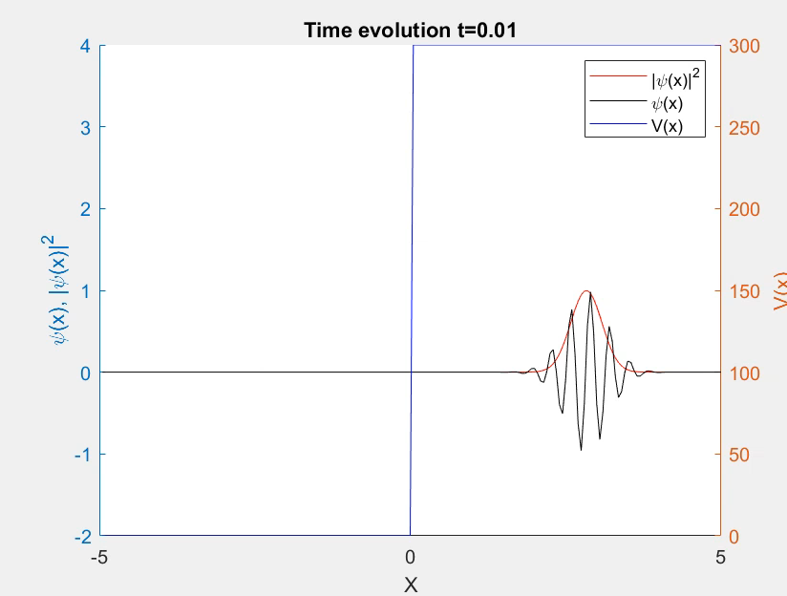
Time evolution of some wavefunctions
Step potential
$$ψ_{0}\left(x\right)=e^{−x^{2}}e^{ikx}$$

Slide 20
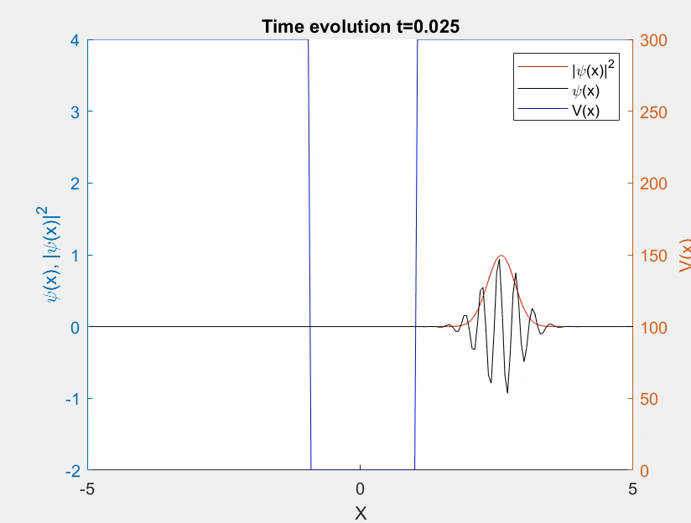
Time evolution of some wavefunctions
Square well
$$ψ_{0}\left(x\right)=e^{−x^{2}}e^{ikx}$$

Slide 21
Future works
Use RK4 and compare the results and run time
Completing the GUI
Any Suggestion from you (but if time allows!)

Slide 22

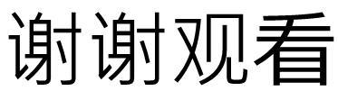
$$谢谢观看$$
Gracias
Ευχαριστώ
धन्यवाद
고맙습니다
Gracias
از توجه شما ممنونم

